Slide 1
bwapp網站安全分析與測試報告
第一版2021/05/25
黃品瑄 4090E041

Slide 2
Agenda
使用docker版的bwapp
web安全測試工具: Burp Suite
HTML Injection - Reflected (GET)
HTML Injection - Reflected (POST)
HTML Injection - Reflected (Current URL)

Slide 3
{註1}不要同時開啟bwapp與DVWA
https://blog.csdn.net/Dome_/article/details/105058897
{註2}解題參考
bWAPP攻略==>
https://blog.csdn.net/weixin_30480651/article/details/99981613
bwapp通關 ==>
https://blog.csdn.net/hxhxhxhxx/article/details/108896596

Slide 4
使用docker版的bwapp

Slide 5
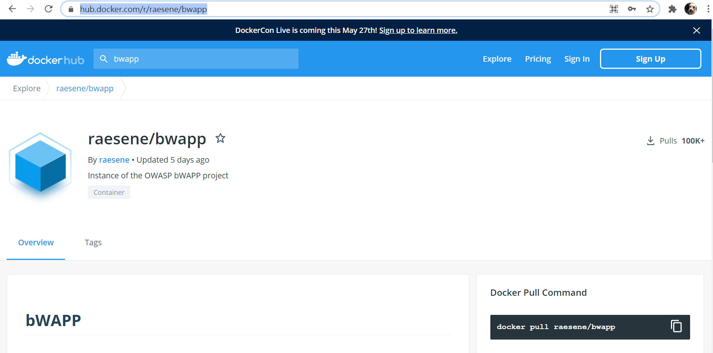
Dockerhub上搜尋bwapp
https://hub.docker.com/r/raesene/bwapp

Slide 6
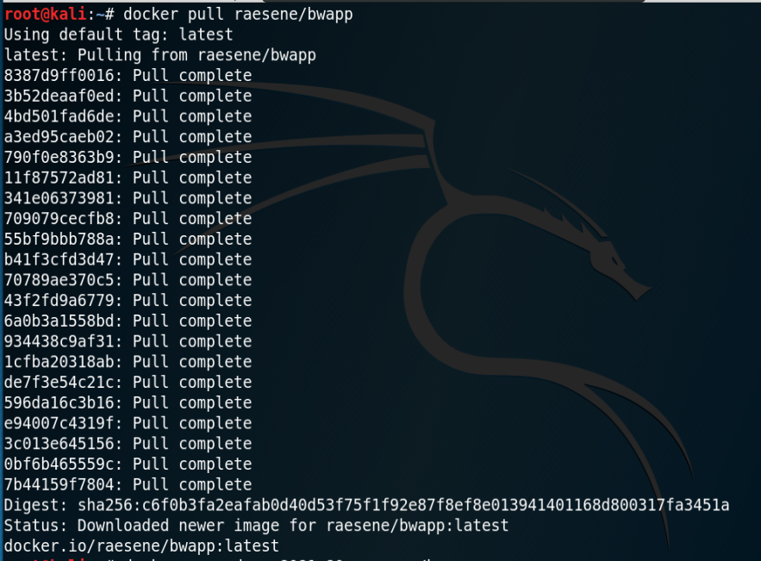
下載image:
docker pull raesene/bwapp

Slide 7

新建container
docker run -d -p 8081:80 raesene/bwapp

Slide 8

查看container
docker ps

Slide 9
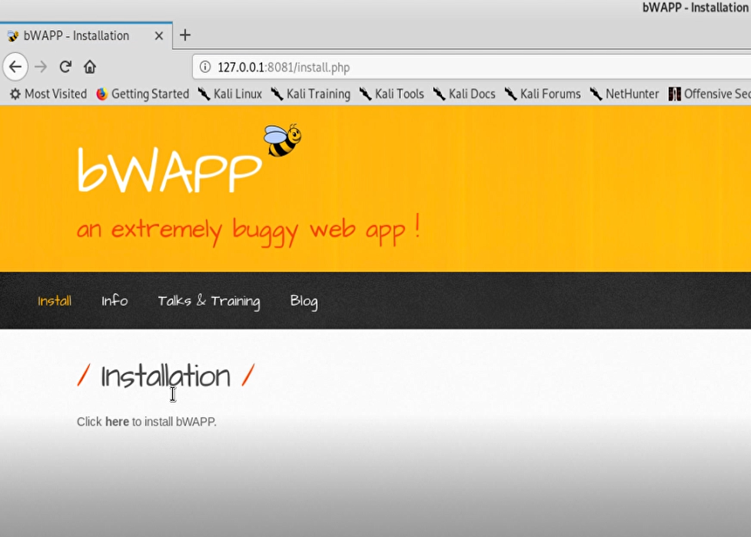
http://127.0.0.1:8081/install.php

Slide 10
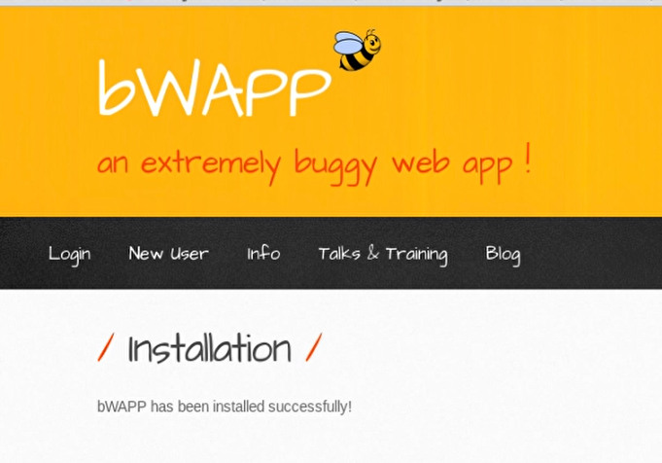

Slide 11
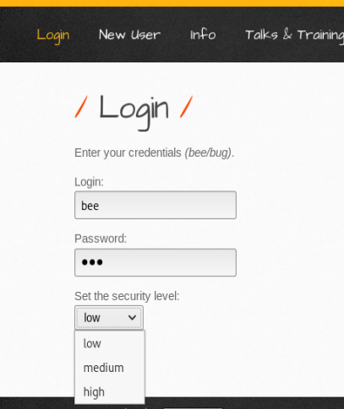
預設帳密：bee/bug

Slide 12
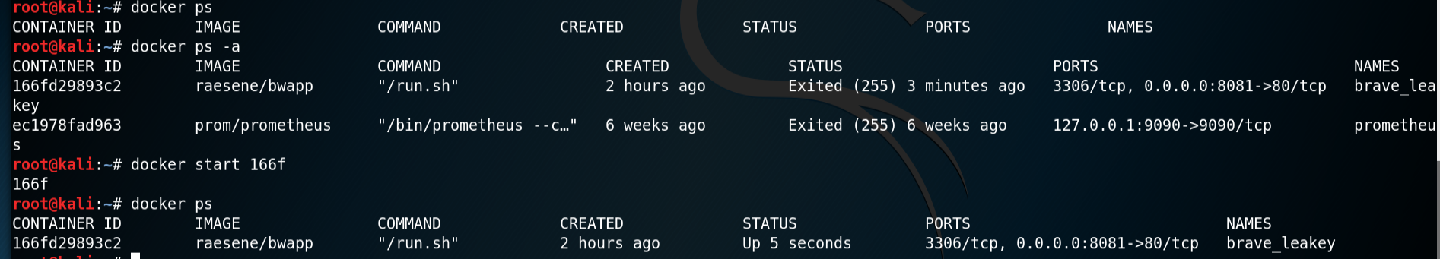
啟動container
docker start [container ID]

Slide 13
web安全測試工具: Burp Suite

Slide 14
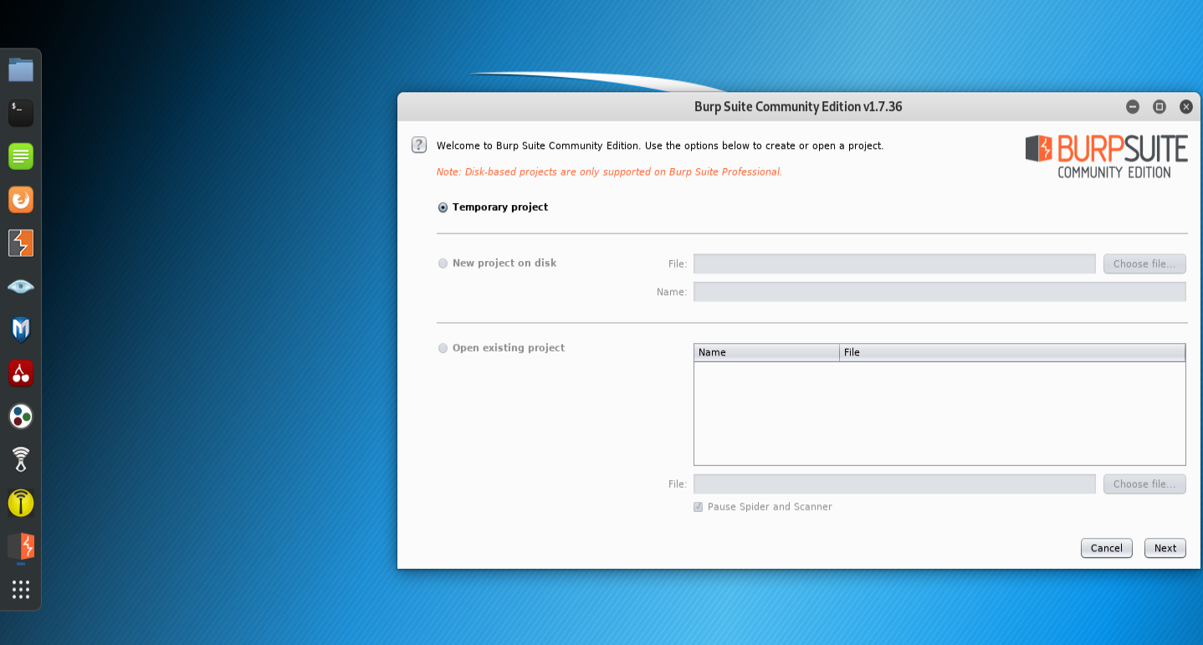
web安全測試工具: Burp Suite

Slide 15
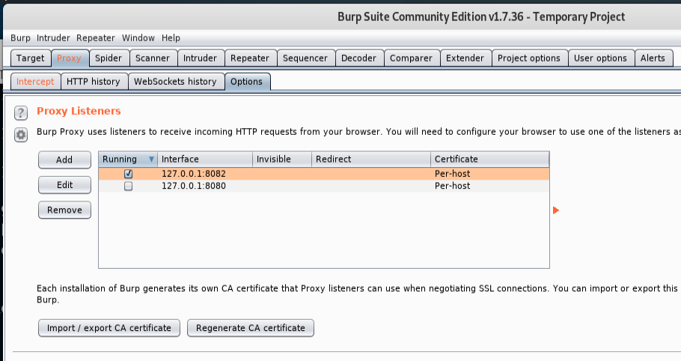

Slide 16
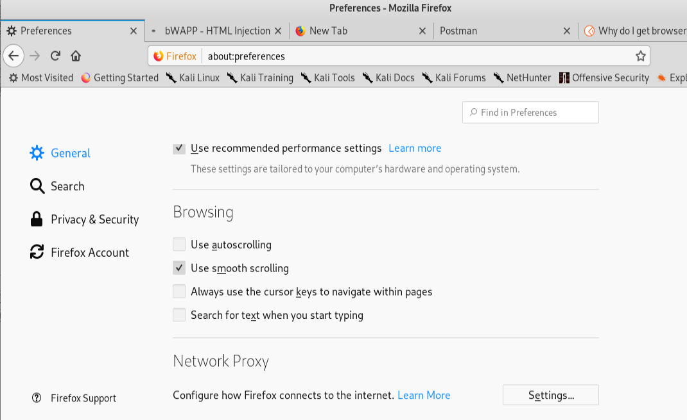

Slide 17
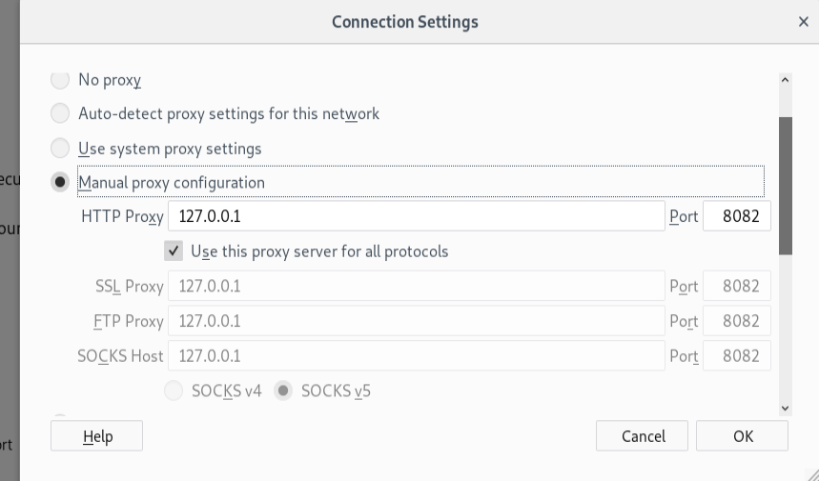

Slide 18
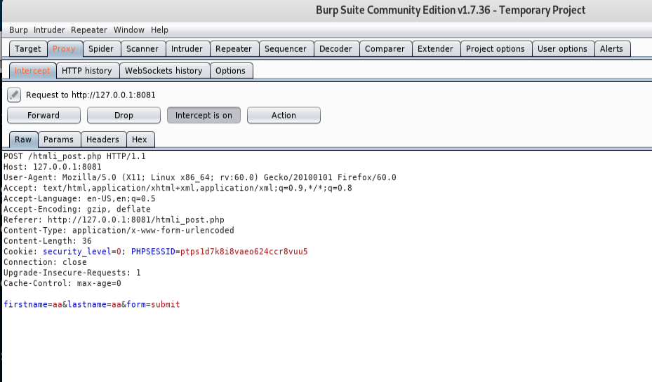

Slide 19
HTML Injection - Reflected (GET)

Slide 20
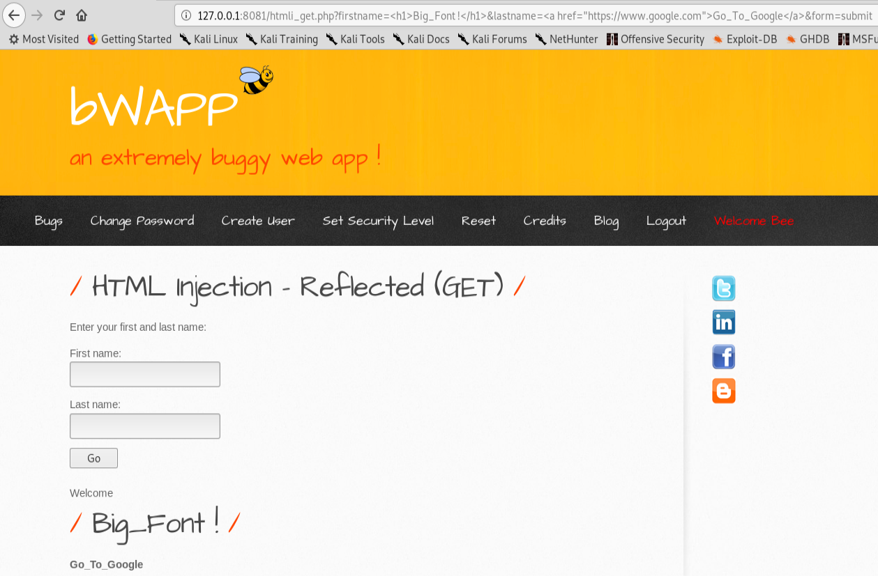

Slide 21
http://127.0.0.1:8081/htmli_get.php?firstname=<h1>Big_Font!</h1>&lastname=<a href= "https://www.google.com">Go_To_Google</a>&form=submit

Slide 22
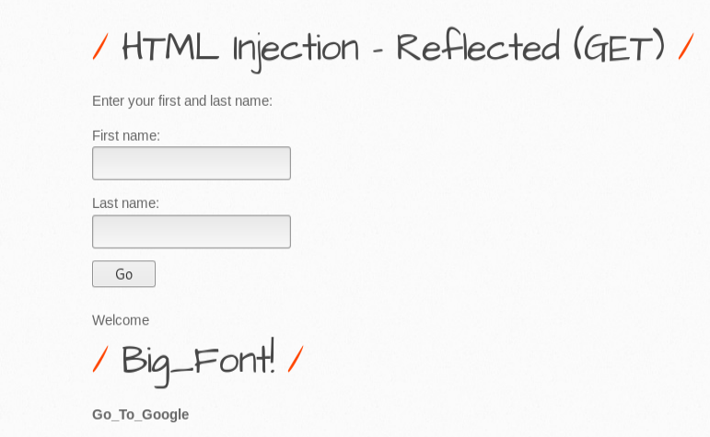
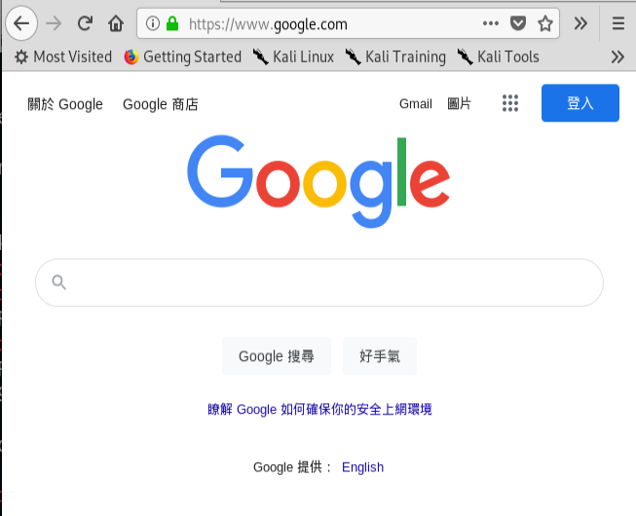

Slide 23
HTML Injection - Reflected (POST)

Slide 24
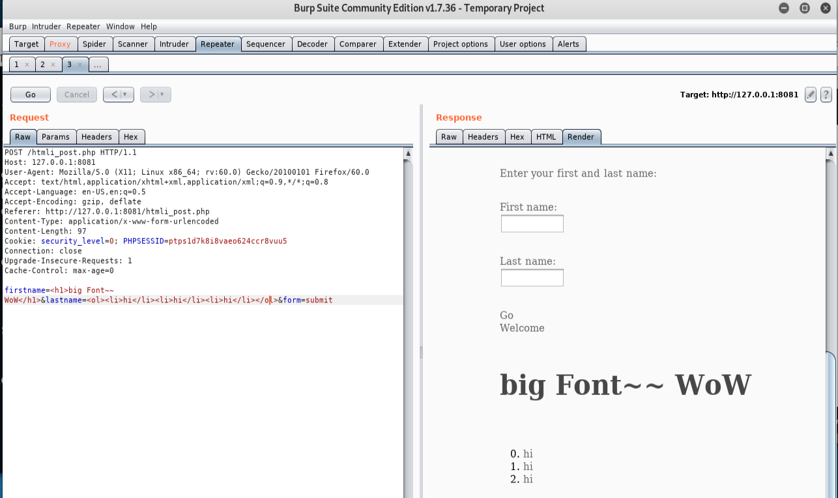

Slide 25
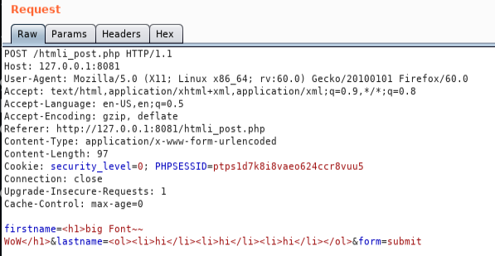

Slide 26
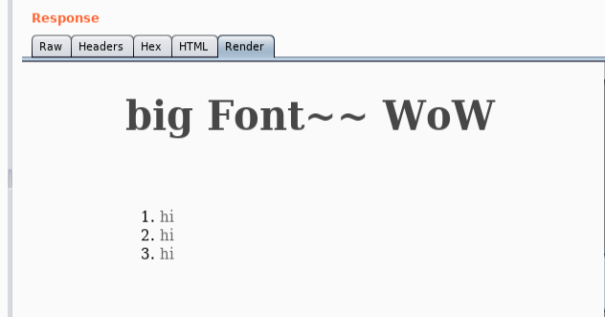

Slide 27
HTML Injection - Reflected (Current URL)

Slide 28
https://blog.csdn.net/weixin_39157582/article/details/86677836

Slide 29
附錄

Slide 30
在kali上安裝chrome
https://www.tecmint.com/install-google-chrome-on-kali-linux/
開啟:
# google-chrome --no-sandbox

Slide 31
https://t0data.gitbooks.io/burpsuite/content/
https://www.hackercat.org/burp-suite-tutorial/burp-suite-browser-and-proxy

